Slide 1


SMART BLIND NAVIGATION SYSTEM USING ARDUINO UNO + PYTHON
Guided by:
Dr.P.Vijayaragavan
Presented by:
Ashika B(192521336)
Narmatha. G. C (192512246)
Ms.S K Aruna

Slide 2
INTRODUCTION
The Smart Blind Navigation System helps visually impaired people move safely.
It uses Arduino Uno and Python for obstacle detection and navigation.
Sensors detect objects or obstacles in front of the user.
The system gives alerts through sound or vibration when an obstacle is found.
It improves the independence, safety, and confidence of blind people while walking.

Slide 3
OBJECTIVE
To develop a smart navigation system for visually impaired people.
To detect obstacles in the user's path using sensors.
To provide immediate alerts through sound or vibration.
To improve safe and independent movement for blind individuals.
To create a low-cost and user-friendly assistive device

Slide 4
PROBLEM STATEMENT
Problem Identification:
About 285 million people worldwide are visually impaired.
Traditional white canes only detect floor-level obstacles.
There is no affordable, real-time AI-based solution widely available.
No proper warning system for mid-air obstacles like open doors, shelves, etc.
Solution:
Use a camera + Python AI to detect objects in front of the user and send instant hardware warnings through Arduino.

Slide 5
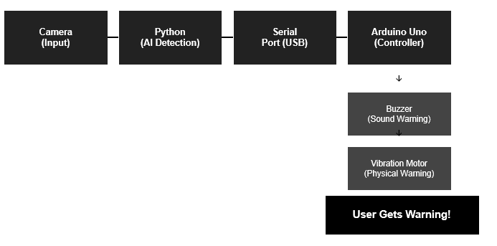
SYSTEM ARCHITECTURE

Slide 6
WORKING PROCESS
Camera starts capturing live video feed from the environment.
Python detects if any object is within a certain distance (using contour area or YOLO bounding box size).
If object is too close → Python sends '1' to Arduino via serial.
Arduino immediately activates the buzzer (beep sound) and vibration motor.
If no obstacle → sends '0' → everything turns off.
The whole loop runs every 0.1 seconds (10 times per second).

Slide 7
Components Used
Hardware
Software
Arduino Uno
USB Camera / Webcam
Buzzer (Active)
Vibration Motor
Jumper Wires
Breadboard
USB Cable (Arduino to PC)
Python 3.x
OpenCV (cv2)
PySerial (serial comm.)
Arduino IDE
YOLOv5 / COCO model (optional AI)
NumPy
Arduino Uno
USB Camera / Webcam
Buzzer (Active)
Vibration Motor
Jumper Wires
Breadboard
USB Cable (Arduino to PC)

Slide 8
MODULE 1: Obstacle Detection Module
This module detects obstacles present in the path of the visually impaired user.
It uses an ultrasonic sensor to measure the distance between the user and nearby objects.
The sensor continuously scans the surroundings for obstacles.
The detected distance data is sent to the Arduino Uno for processing.
This module helps prevent collisions and improves user safety.

Slide 9
MODULE 2: Alert and Navigation Module
This module receives obstacle information from the detection module.
It generates alerts through a buzzer, vibration motor, or voice output.
The alerts help the user identify nearby obstacles quickly.
Python can be used to provide simple voice guidance for navigation.
This module supports safe and independent movement for visually impaired users.

Slide 10
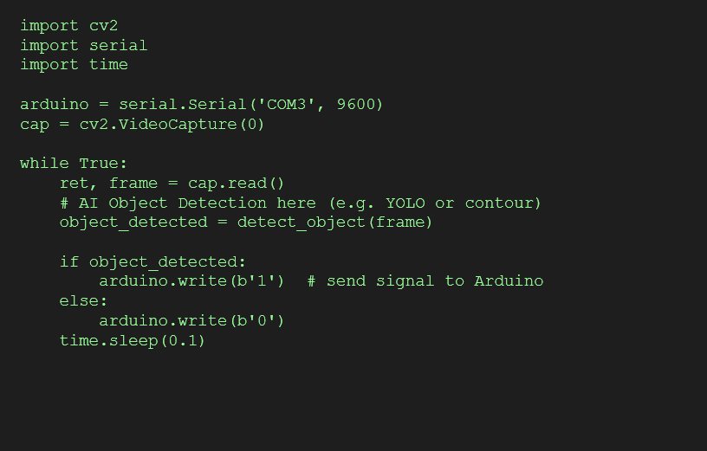
PYTHON CODE – MAIN LOGIC

Slide 11
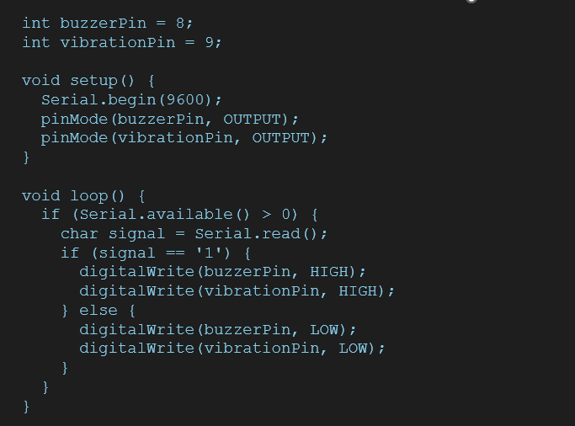
ARDUINO CODE – HARDWARE CONTROL

Slide 12
ADVANTAGES
Low Cost – Arduino Uno + a basic webcam is very affordable.
Real-Time Detection – The system runs continuously and warns the user instantly.
No Internet Required – Everything works locally (offline system).
Multi-Sense Warning – Buzzer gives sound AND vibration motor gives physical feedback at the same time.
Easy to Build – Simple components, standard code, beginner-friendly.
Python-Powered – Python is flexible and we can easily improve the AI part later.

Slide 13
LIMITATIONS
Needs a laptop/PC to run the Python code – not fully standalone yet.
Camera has a limited field of view – side objects may not be detected.
Works less effectively in low-light conditions.
No distance measurement – only tells 'object found', not 'object is 1 meter away’.
Serial cable (USB) makes it less portable – wireless not implemented yet.

Slide 14
FUTURE SCOPE
Voice Announcements – Instead of just a buzzer, Python can use text-to-speech (like pyttsx3) to say 'Object ahead!' in the user's earphone.
Ultrasonic Sensor Integration – Add HC-SR04 to measure actual distance and warn 'Object at 50cm’.
Raspberry Pi – Move the Python code to Raspberry Pi so no laptop is needed (fully portable wearable).
GPS Navigation – Help the user navigate to a specific location by integrating maps.
Wireless (Bluetooth/WiFi) – Remove the USB cable between Python and Arduino.

Slide 15
CONCLUSION
The Smart Blind Navigation System helps visually impaired people navigate safely and independently.
The combination of Arduino Uno and Python enables accurate obstacle detection and real-time assistance.
The system provides timely alerts through sound, vibration, or voice guidance to avoid obstacles.
It is a cost-effective and user-friendly solution that improves the mobility and confidence of blind individuals.
This project demonstrates how technology can enhance safety, accessibility, and quality of life for visually impaired people

Slide 16
REFERENCE
Banzi, M., & Shiloh, M. (2022). Getting Started with Arduino (4th Edition). Maker Media, Inc.
Monk, S. (2020). Programming Arduino: Getting Started with Sketches (3rd Edition). McGraw-Hill Education.
OpenCV Documentation. Open Source Computer Vision Library. Available at: OpenCV Official Website
Python Software Foundation. Python Programming Language Documentation. Available at: Python Official Website
Arduino Documentation. Arduino Uno and Sensor Interfacing Guides. Available at: Arduino Official Website

Slide 17


